Slide 1

Welcome
to

Slide 2


Slide 3

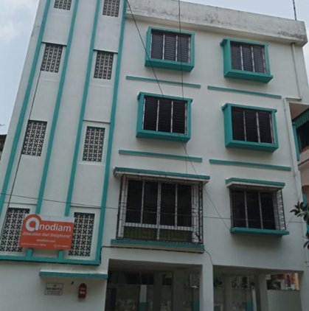


And
© PROTECTED ANODIAM 2023 || PRIVATE & CONFIDENTIAL

Slide 4
Swim Lanes
Tech
Commerce
Law
NEET/IIT
VIII to XII Science
Humanities
Professional Courses
Junior Section
Competitive
Co Curricular
© PROTECTED ANODIAM 2023 || PRIVATE & CONFIDENTIAL

Slide 5

Support for Our Faculty
Best talents in the field
Rewarding career growth
Teamwork & synergy
Gratifying environment
Effective marketing support
Feature rich app support
© PROTECTED ANODIAM 2023 || PRIVATE & CONFIDENTIAL

Slide 6
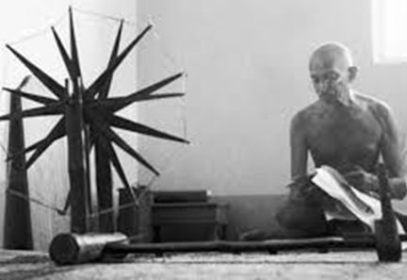
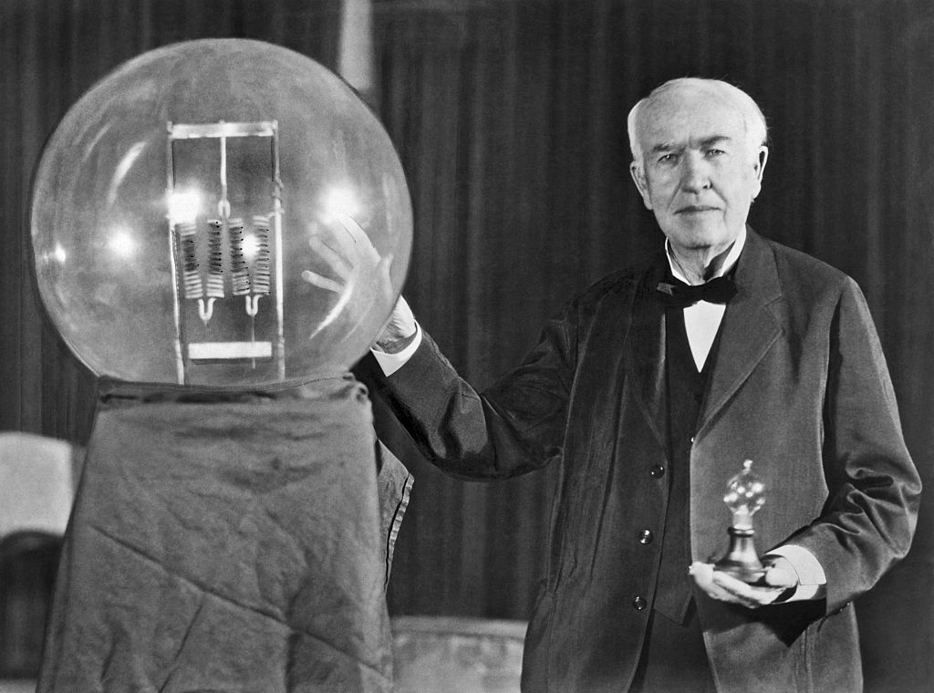
Empathy and Innovation
And
© PROTECTED ANODIAM 2023 || PRIVATE & CONFIDENTIAL

Slide 7
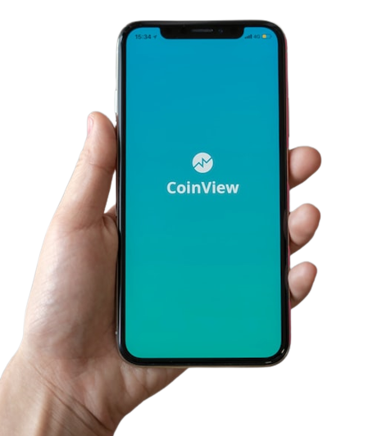

Data is Future
© PROTECTED ANODIAM 2023 || PRIVATE & CONFIDENTIAL

Slide 8

Branding
Welcome!
© PROTECTED ANODIAM 2023 || PRIVATE & CONFIDENTIAL

